Slide 1
JPS Community Needs Assessment
April 30, 2010

Slide 2
Table of Contents
Demographic Assessment and Defining the Study Population
Health Status Needs Indicators
Tarrant County Health Care Service Providers Supply
Health Services Utilization
Clinic Capacity and Wait Times
Correlations and Conclusions
Recommendations

Slide 3
DEMOGRAPHIC ASSESSMENT and Defining the Study Population

Slide 4
Summary of Study Population Calculation
1,726,892
Tarrant County Pop. in 2009
694,769
Pop. < 250% FPL
633,220
Pop. Under 65 & < 250% FPL
317,700
Pop. Under 65, < 250% FPL and Uninsured
This is the entire population of Tarrant County (including the undocumented).
Using income by household from Claritas, determined the # of HH & people < 250% FPL by using poverty guidelines provided by JPS. – Calculations performed at zip level.
Assuming < 250% FPL population is distributed according to overall age distribution (9% is 65+), calculated the <250% FPL pop under the age of 65. – Calculations performed at zip level.
According to SAHIE (Small Health Area Insurance Estimates) 50.5% of the Tarrant Co. pop that is less than 200% FPL is also uninsured. The pop under 65 & < 250% FPL was multiplied by 50.5% to calculate the study population.
** See next page for breakdown of study population
Sources: Claritas population by age group and zip code via Thomson Market Planner Plus. HHI was provided by Claritas via Thomson Market Planner Plus.
Small Health Area Insurance Estimates (SAHI) 9/09 Report based on 2006 Census Data for Tarrant County.

Slide 5
Defining the Study Population
The population for this study is intended to identify those residents of Tarrant County likely to seek JPS facilities and providers for services.
In order to achieve this, we have included the following individuals:
All residents aged 65 and under who are below 250% of the Federal Poverty Level and are uninsured.
This includes individuals who are:
Under 65, below 250% of FPL, but may qualify for Medicare Disability
Under 18, below 250% of FPL, and qualify for SCHIP
Undocumented
These groups have been included because they represent community medical need and would likely seek services through JPS. This is not intended as an analysis of the JPS Connection eligible population.
Of the 317,700 individuals that make up the population of this study, the breakdown of are estimated as the following:
Ineligible – Undocumented – 30,000 (calculated using residual methodology)
Ineligible – Children Qualifying for SCHIP – 98,668 (31.1% of the population)
Documented, under age 65, uninsured, below 250% of FPL – 189.032

Slide 6
Health Status Needs Summary
Health status needs of each service area have been aggregated by these 5 measures relative to how the needs of the county are being met.
The South East, Central, South Central, North West and South Arlington service areas appear to have the greatest needs from a health status perspective.

Slide 7
Demand Summary
South East and Central are the only two service areas that are in the top 5 of both the demographic and health status needs summary.
In total, 8 of the 11 service areas appear in the top 5 of each of these categories, indicating that the demand for services across Tarrant County is vast.

Slide 8
Summary and Conclusions - Demand
The study population is 317K in Tarrant County.
Includes under 65 years of age, below 250% of FPL, including children, undocumented, and Medicare disability.
Demographics indicate that the Central, South East, North Arlington, West, and HEB service areas have the highest demand for services.
Health status indicators suggest that the greatest demand for services are in the South East, Central, South Central, North West, and South Central service areas.
Combining these two demand factors suggests that that greatest needs are in the South East, Central, North Arlington, North West, and South Central service areas.

Slide 9
TARRANT COUNTY HEALTH CARE SERVICE PROVIDERS (Supply)

Slide 10
Access to Services Summary
South Central, Central, Grapevine/CV, North Arlington, South Arlington, South West, and North Central have the least access to services for the study population.

Slide 11
Summary and Conclusions - Supply
Supply of acute care beds for the study population within Tarrant County is slightly less than the county at large.
When looking at drive times to hospitals, a 30 minute drive time was used as this is a typical planning parameter. That comparison shows that there are an adequate number of beds per 100K study population within a 30 minute drive of each service area (including out of county beds) as compared to the number of beds per 100K for the service area.
All of these acute care hospitals have emergency departments, and thus it is reasonable to conclude that there is adequate ED coverage for the study population as well.
Urgent care clinics are scattered throughout the county; in comparing them to where the highest numbers of study population live, there are fewer in those areas than in others. This is expected since most of these are for-profit providers that target areas of better payer mix. The two JPS urgent care clinics are accessible to most of the county within 30 minutes
There is an undersupply of primary care providers for the entire county, including the study population.
This undersupply varies widely by service area, which can be attributed to the geographic distribution of hospital locations.

Slide 12
Key Medical needs IP, OP ED and Amb. Surg. Utilization

Slide 13
JPS Market Share
JPS’s market share by service areas varies from the JPS market share for Tarrant County as a whole.
Areas such as Grapevine/CV, HEB, North West, North Central, South Arlington, and North Arlington, and South West are area where for 1 or more services (Inpatient, Outpatient ED, and Ambulatory Surgery) that JPS market share is less than the JPS market share for the county.
Thus, these are areas where JPS’ market share could be increased, particularly if the needs of the community are not being met by another provider.
Absolute population is not a part of market share calculation.

Slide 14
Clinic Capacity and wait times

Slide 15
Summary and Conclusions - Utilization
Inpatient services appear to be appropriately utilized by the study population, with a 2% under utilization.
Emergency rooms appear to be overutilized by the study population by close to 45%, suggesting that ED’s may be being used as a primary point of access by this group. This may be an indicator of limited access to urgent care and primary care.
Ambulatory surgery services are underutilized compared to expected use rates for the population by 36%, suggesting inadequate access to these services.
JPS has the greatest market share in South East, Central, South Central, West, and South West service areas.
Grapevine/CV, HEB, North West, and North Central are the areas where the needs of the study population are being met the most by other providers and being met the least by JPS.
The JPS clinics appear to have higher productivity as compared to expected FTE performance to median MGMA benchmarks

Slide 16
correlations and conclusions

Slide 17
Acute Care Needs Assessment
Supply of acute care beds per 100K study population (144) is lower than the supply for the total population (205).
Service areas 30 minute drive time study shows that there is an adequate number of acute care beds to meet the needs of the study population.
Actual utilization of inpatient services shows only a very slight gap relative to the expected utilization (less than 2%), indicating that the study population is being served at either JPS or another facility.
When compared to the largest county hospital service districts in Texas, only Harris County has more acute care beds for the study population.
Acute care market share of the study population for JPS is 52%. JPS captures greater than the average market share in 4 of the 6 service areas with the highest demand. Other areas JPS has lower market share, suggesting other providers are meeting the need.
The conclusion then is that there is an adequate supply of acute care beds to meet the needs of the study population of Tarrant County.

Slide 18
Outpatient Care Needs Assessment
Multiple factors need to be considered to assess outpatient needs:
Emergency services
Urgent care service
Clinic services
Using inpatient hospitals as a proxy for access to emergency departments, there appears to adequate supply of emergency services for the population.
In addition, actual utilization of emergency services by the study population is 45% higher than projected utilization, which may suggest that the population utilizes emergency services for primary care as opposed to clinics and urgent care centers, suggesting a potential access issue.
ED market share of the study population for JPS is 31%. JPS captures greater than the average market share in 4 of the 6 service areas with the highest demand. Other areas JPS has lower market share, suggesting other providers are meeting the need.
ED visits coded as non-emergent may be a barometer of lack of access to urgent and primary care, and are evident in several of the service areas where need is high.

Slide 19
Outpatient Needs Assessment
Urgent care providers are primarily located in geographies where the study population is not.
Primary care utilization is high in the JPS clinics, with productivity per provider FTE exceeding expected MGMA benchmarks.
Primary care provider FTE’s supply is lower than demand for the study population, and for Tarrant County as a whole.

Slide 20
Recommendations to fill gaps

Slide 21
Meeting The Needs of Tarrant County
No additional acute care beds are necessary, as the needs are currently being met.
Continued monitoring of acute care bed utilization is warranted.
Acute Care Services
Emergency and Urgent Care Services
Emergency department services for the study population are currently being met, and thus there appears to be no need for additional ER capacity.
JPS should add urgent care services to meet the needs of those seeking non-emergent and primary care in the ED’s in some of its service areas.
Consolidation of Services
JPS primary care clinics appear to be operating at or above capacity in many locations, and should be expanded to meet the needs of the study population.
In order to continuously monitor and update the needs of the community, a more streamlined approach to monitoring clinic FTE’s, visits, and wait to next visit times should be considered.
JPS Primary Care Clinics
Consolidation of Services
Ambulatory surgery expected utilization is not being met for the study population in Tarrant County; thus, investment to increase access should be condsidered.
Tracking of referrals by geography should be done to determine best location based on need.
Ambulatory Surgery
Consolidation of Services

Slide 22
Urgent Care Clinic Expansion
JPS should add urgent care clinics in Tarrant County in order to best meet the needs of the study population:
Reduce current ED overutilization
Reduce non-emergent ED visit classifications
Reducing demand on PCP clinics
Creation of lower cost avenues of care
Locations of urgent care clinic should be driven by the following factors:
Absolute volume of study population
Drive times to existing JPS urgent care facilities
Magnitude of ED overutilization from study population in a service area
Magnitude of non-emergent ED visits in a service area
Magnitude of primary care wait times for access
These variables have been looked at in correlation in the next several pages, which will inform areas of need for urgent care.

Slide 23
Urgent Care Prioritization, Variable 1
The top right quadrant is where the highest ED overutilization and non-emergent ED visits are.
The size of the bubble is demand (absolute study population and health needs).
Based on this, JPS could consider prioritization of urgent care clinics in:
Central
South East
North Arlington
South Arlington
South Central
HEB

Slide 24
Urgent Care Prioritization, Variable 1 Data Table

Slide 25
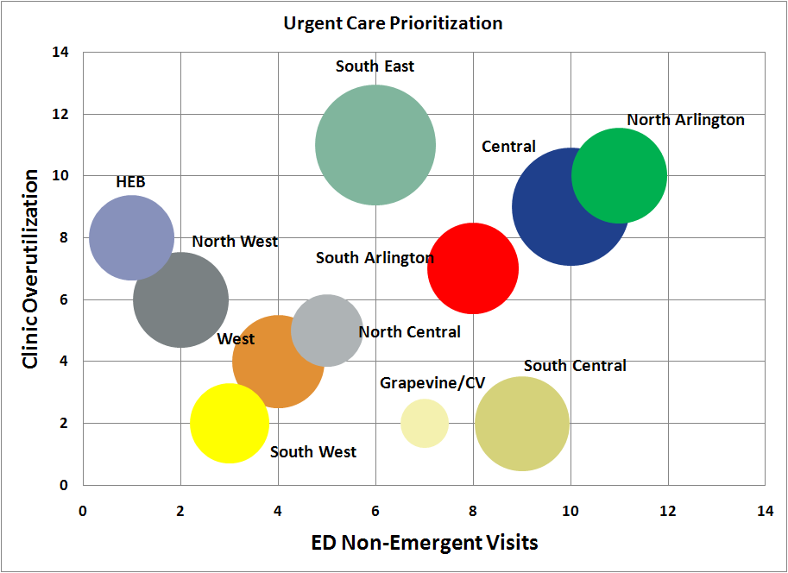
Urgent Care Prioritization, Variable 2
The top right quadrant is where the highest non-emergent ED visits and JPS Primary Care Clinic overutilization are.
The size of the bubble is demand (absolute study population and health needs).
Based on this, JPS could consider prioritization of urgent care clinics in:
Central
North Arlington
South East
South Arlington
South Central
North West

Slide 26
Urgent Care Prioritization, Variable 2 Data Table

Slide 27
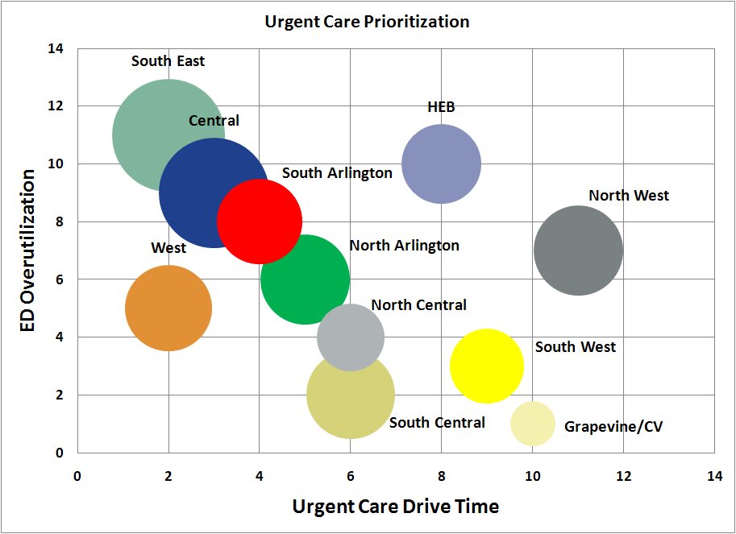
Urgent Care Prioritization, Variable 3
The top right quadrant is where the highest ED overutilization and longest JPS urgent care drive times are.
The size of the bubble is demand (absolute study population and health needs).
Based on this, JPS could consider prioritization of urgent care clinics in:
North West
South East
HEB
Central
South Arlington
North Arlington

Slide 28
Urgent Care Prioritization, Variable 3 Data Table

Slide 29
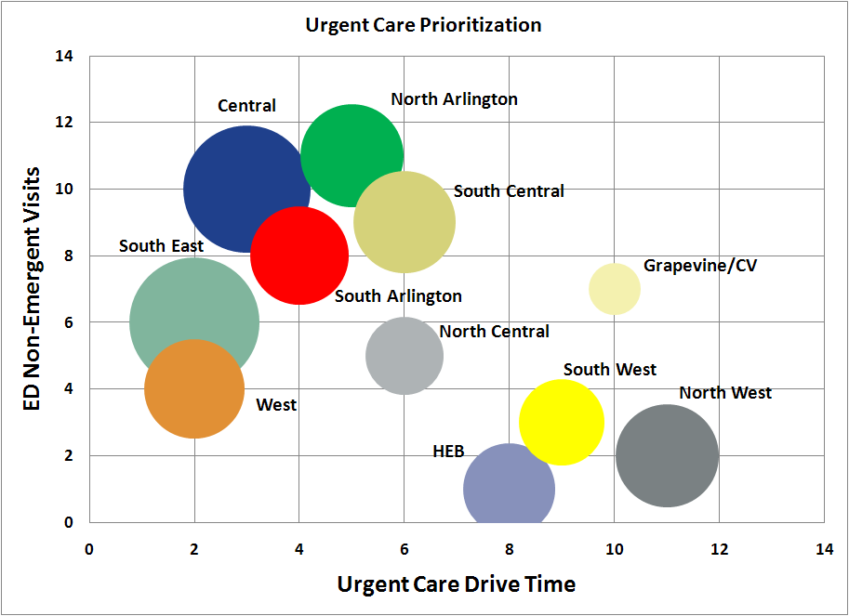
Urgent Care Prioritization, Variable 4
The top right quadrant is where the highest ED non-emergent visits are highest and JPS Urgent Care Drive time is the longest.
The size of the bubble is demand (absolute study population and health needs).
Based on this, JPS could consider prioritization of urgent care clinics in:
Central
North Arlington
South Central
North West
Grapevine/CV
South Arlington

Slide 30
Urgent Care Prioritization, Variable 4 Data Table

Slide 31
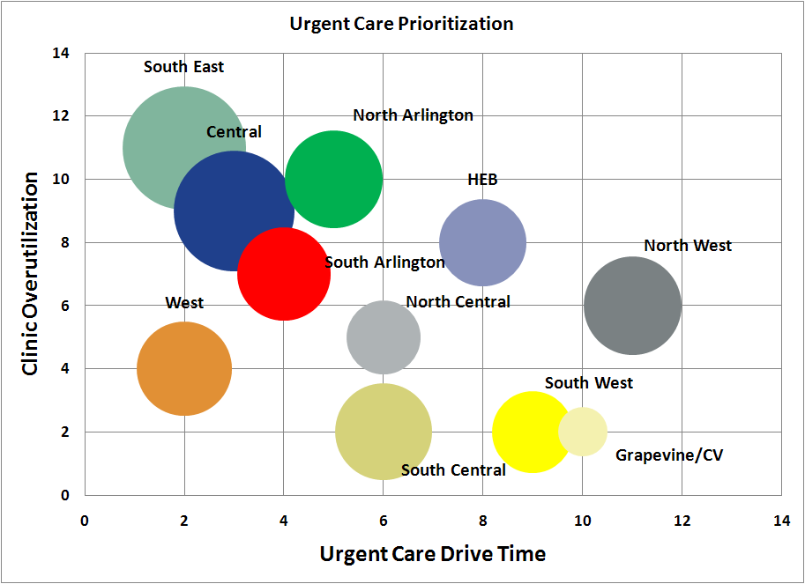
Urgent Care Prioritization, Variable 5
The top right quadrant is where clinic overutilization is highest and JPS Urgent Care Drive time is the longest.
The size of the bubble is demand (absolute study population and health needs).
Based on this, JPS could consider prioritization of urgent care clinics in:
North West
South East
Central
North Arlington
HEB
South Arlington

Slide 32
Urgent Care Prioritization, Variable 5 Data Table

Slide 33
Primary Care Clinic Expansion
JPS should add primary care clinics in Tarrant County in strategic locations to increase access to PCP’s and to decrease the burden on currently highly productive clinic locations.
The following factors should be considered in PCP clinic location determinations:
Absolute volume of study population
Magnitude of JPS PCP clinic overutilization from study population in a service area
Magnitude of supply of PCP’s for the study population in a service area

Slide 34
Primary Care Clinic Prioritization
The top right quadrant is where the highest JPS PCP clinic overutilization and highest PCP need are.
The size of the bubble is study population.
Based on this, JPS could consider prioritization of primary care clinics in:
Central
HEB
North Arlington
South East
North West
South Arlington
It is important to note that there are no Primary Care clinics presently in South Central, Grapevine/CV, and South West.

Slide 35
Primary Care Clinic Prioritization Data Table

Slide 36
Additional Primary Care Clinic Needs
Physician Supply and Demand
Physician supply and demand for the market suggests that there are an inadequate number of primary care providers for the study population, and for Tarrant County as a whole.
A recruitment plan for primary care providers (both physician and extender) should be created to meet the needs of any newly created JPS locations (urgent care and primary care clinics) as well as any undersupplied existing locations.
Management and Data Tracking
Clinic management and data tracking should be centralized as much as possible to achieve economies of scale and to ensure uniformity and consistency.
The development of standardized methodologies for provider FTE tracking, visit tracking, wait times tracking, productivity, and other key performance metrics should be put in place in order to maximize efficiencies and enable ongoing monitoring of community needs.

Slide 37
Ambulatory Surgery
Ambulatory surgery is underutilized by the study population, which is likely an access issue.
Ambulatory surgery will help to create a lower cost of care location for provision of outpatient surgical services.
Tracking of referrals for ASC appropriate procedures by clinic and geographic location should begin in order to determine the best location for ASC service expansion.

